Slide 1

Drum roll please..

Slide 2
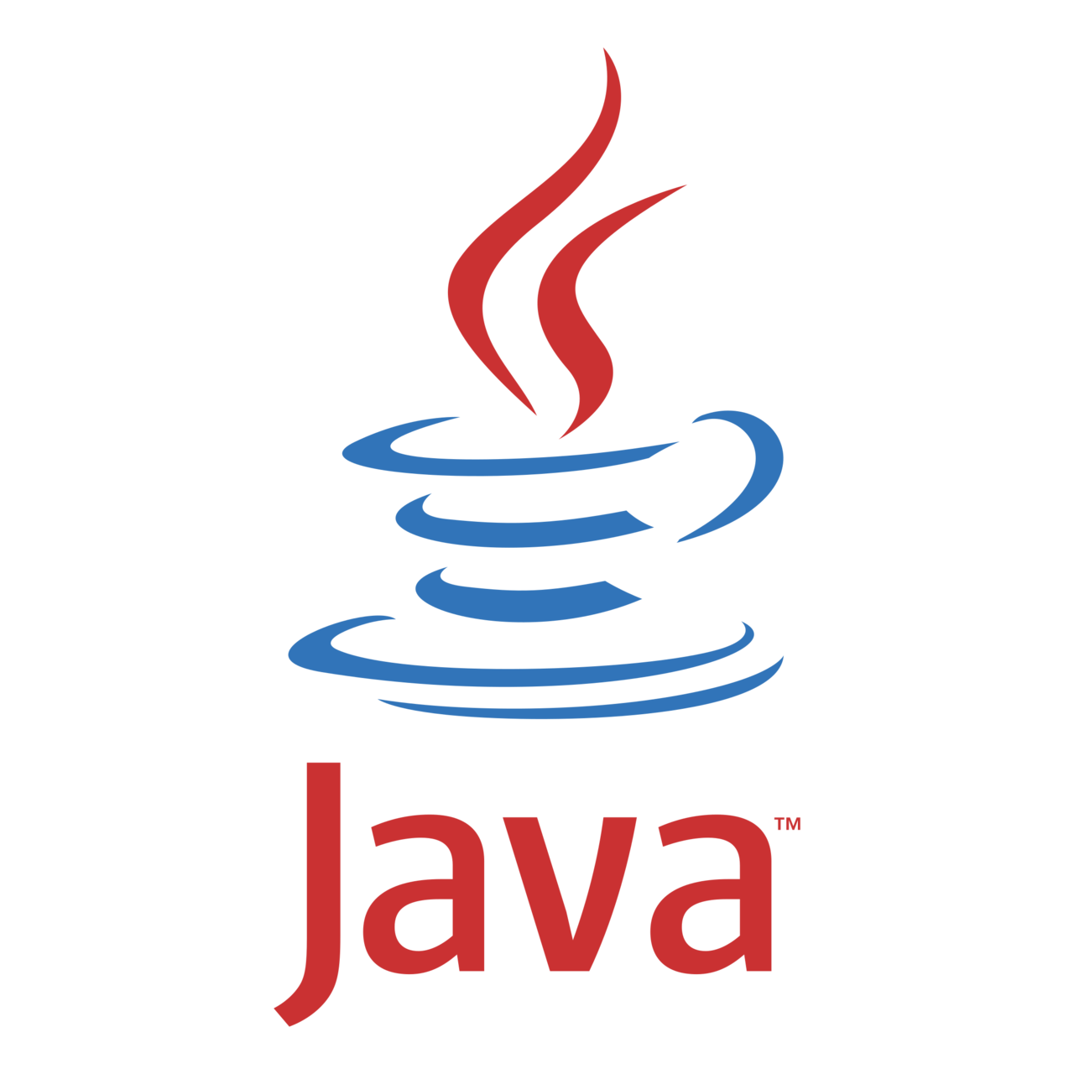


Slide 3


James Gosling

Slide 4


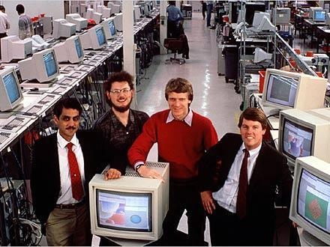
MID
1990

Slide 5

“Oak”

Slide 6

I am a fan of coffee, so…
[energy ,excitement]

Slide 7
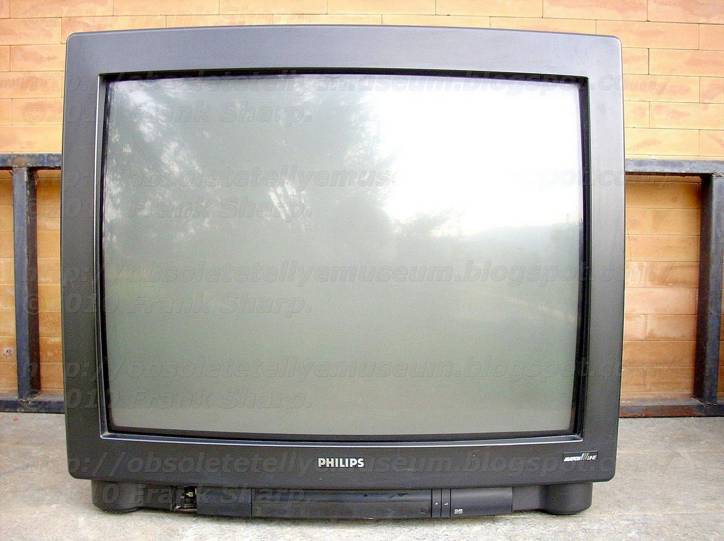


Slide 8

2010

Slide 9
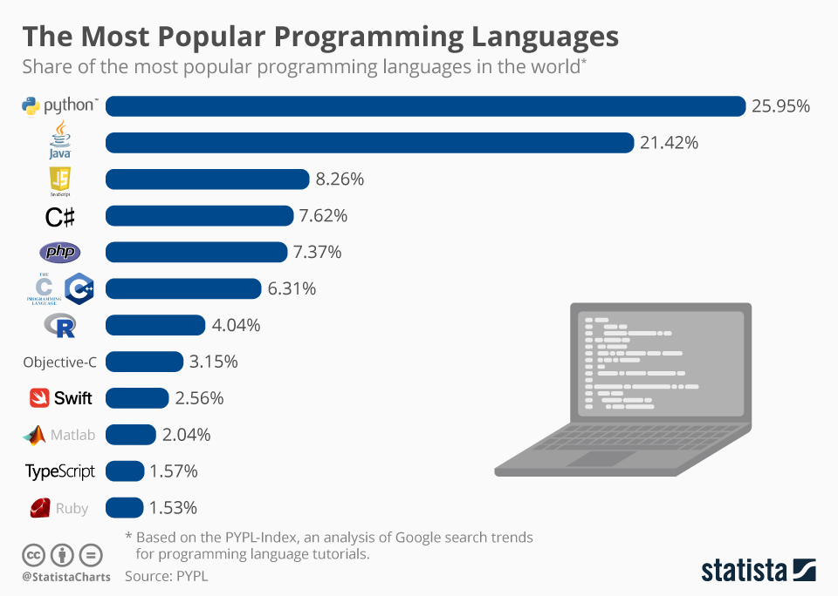

Slide 10

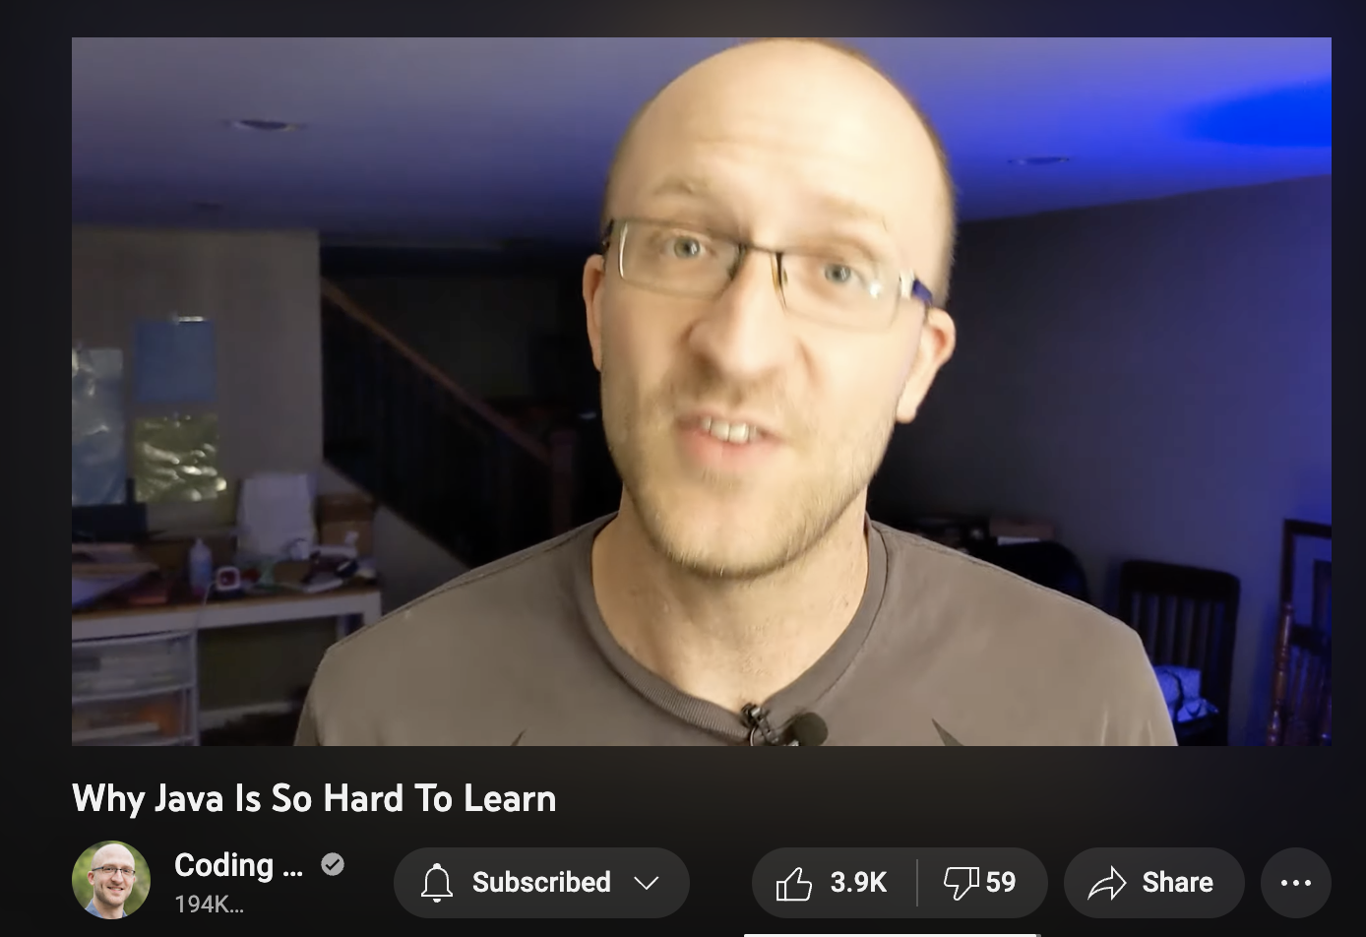



Slide 11


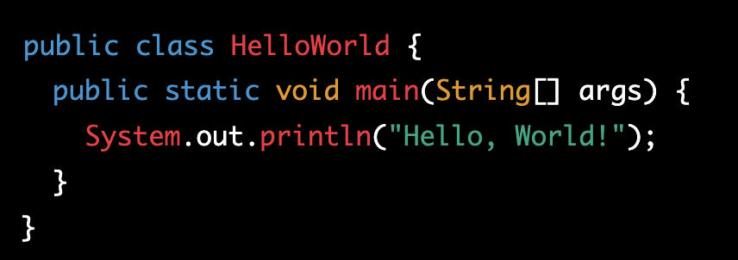


Slide 12


Slide 13
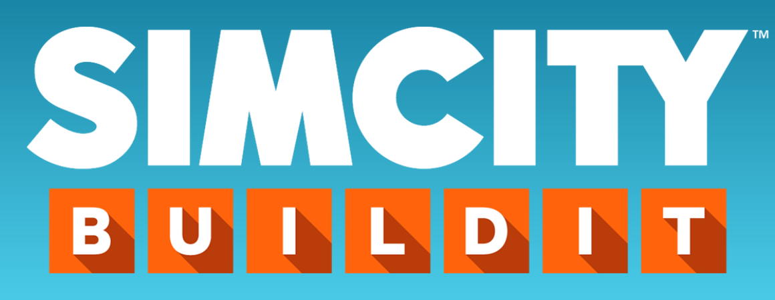



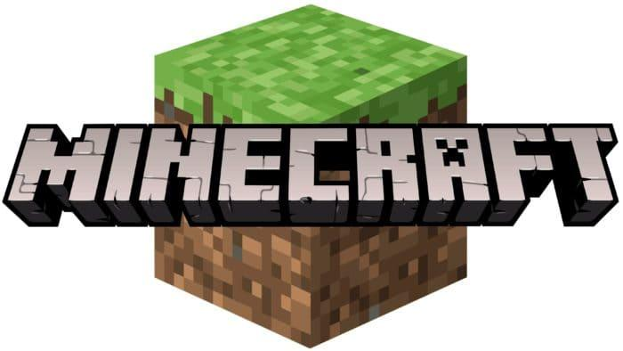


Slide 14
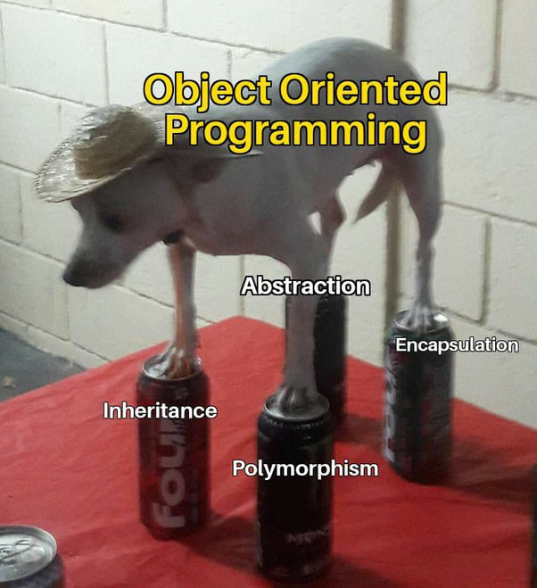
Chapter 1.1
Overview of Object-oriented Programming in Java

Slide 15


Alan Kay

Slide 16
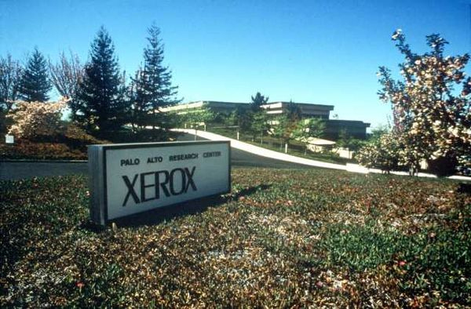

1960s - 1970s
SmallTalk

Slide 17
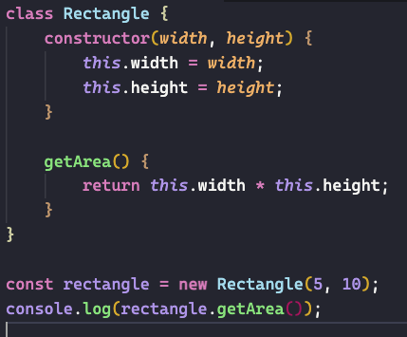
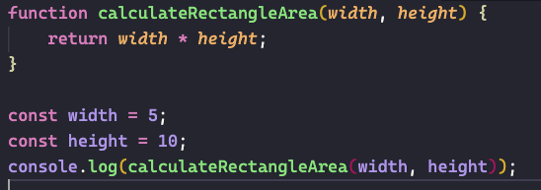

Slide 18
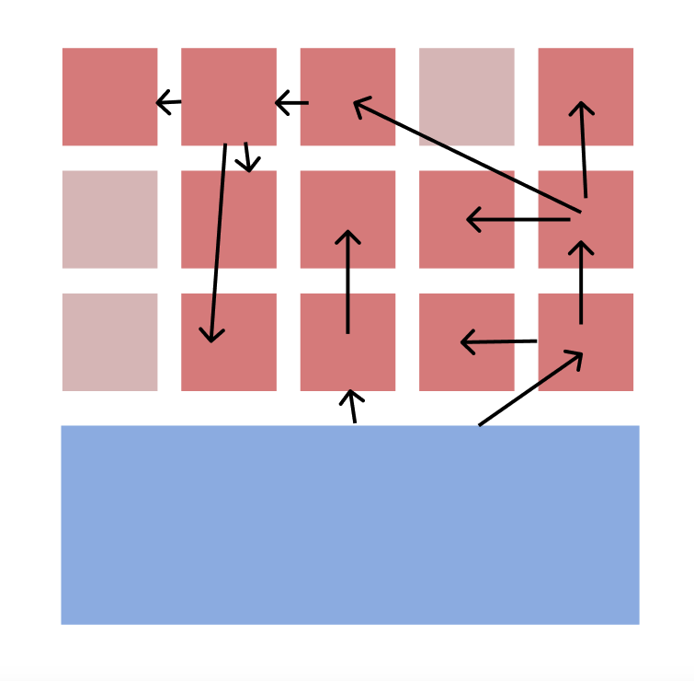
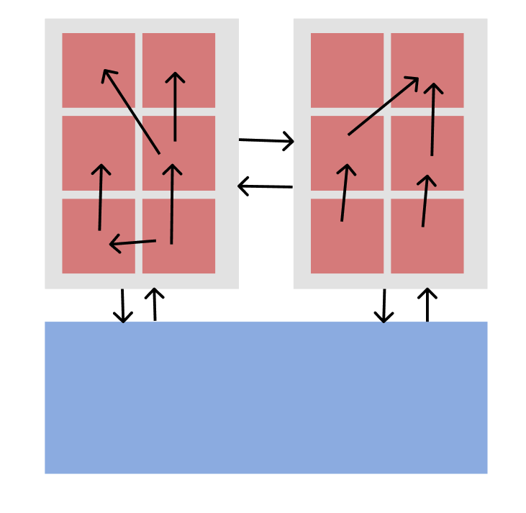

Slide 19
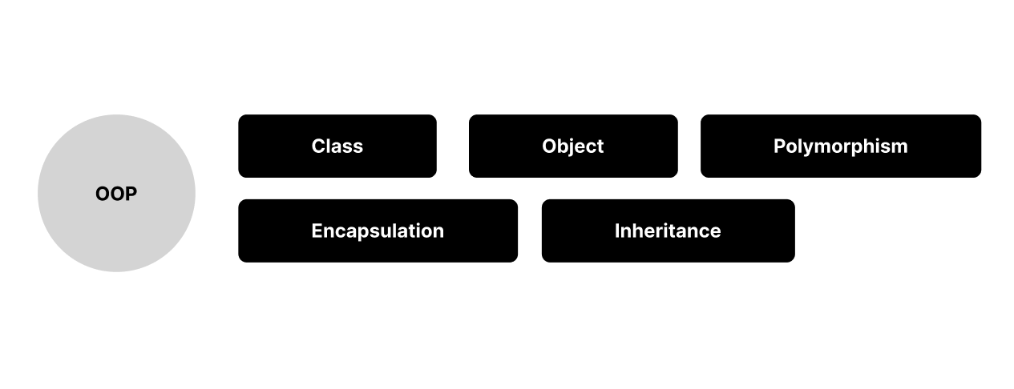
The core concepts of OOP in Java

Slide 20

Class & Object
class
object
Class: A blueprint or template for creating objects. It defines the properties and methods of the object.
Object: An instance of a class. An object is an individual instance of a class and has its own state and behavior.

Slide 21



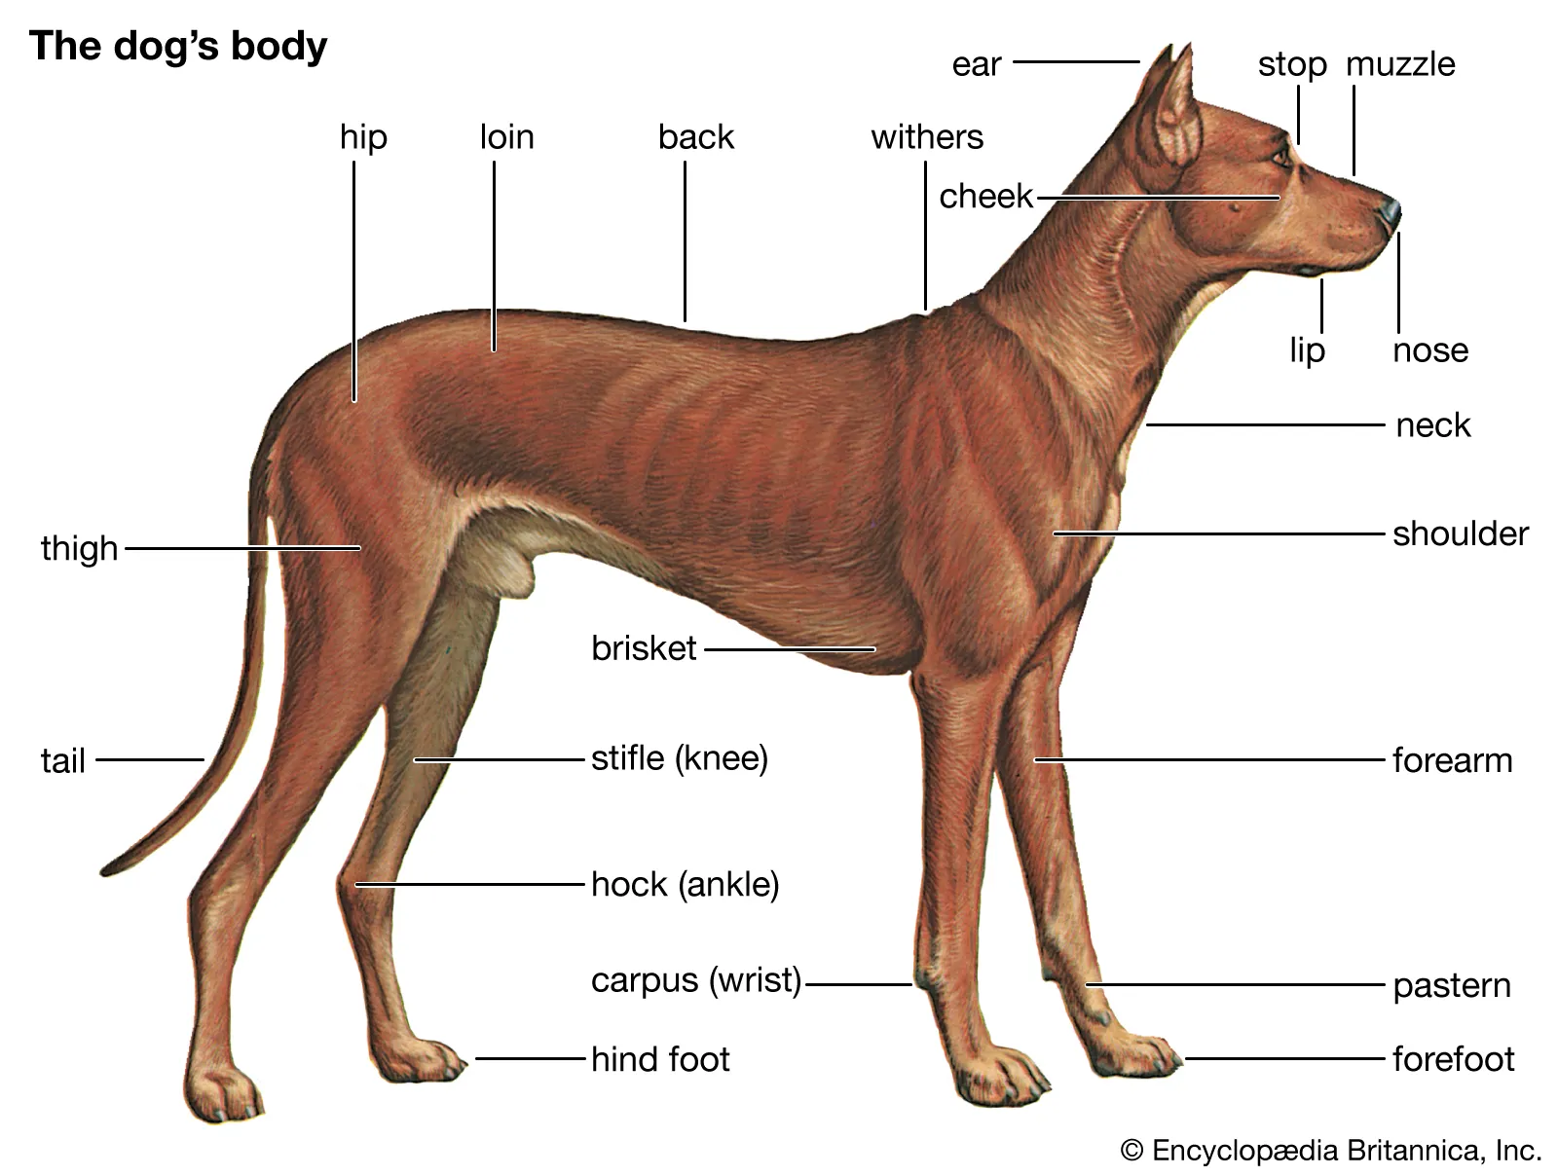



Class
Objects

Slide 23

Abstraction and Encapsulation

Slide 24
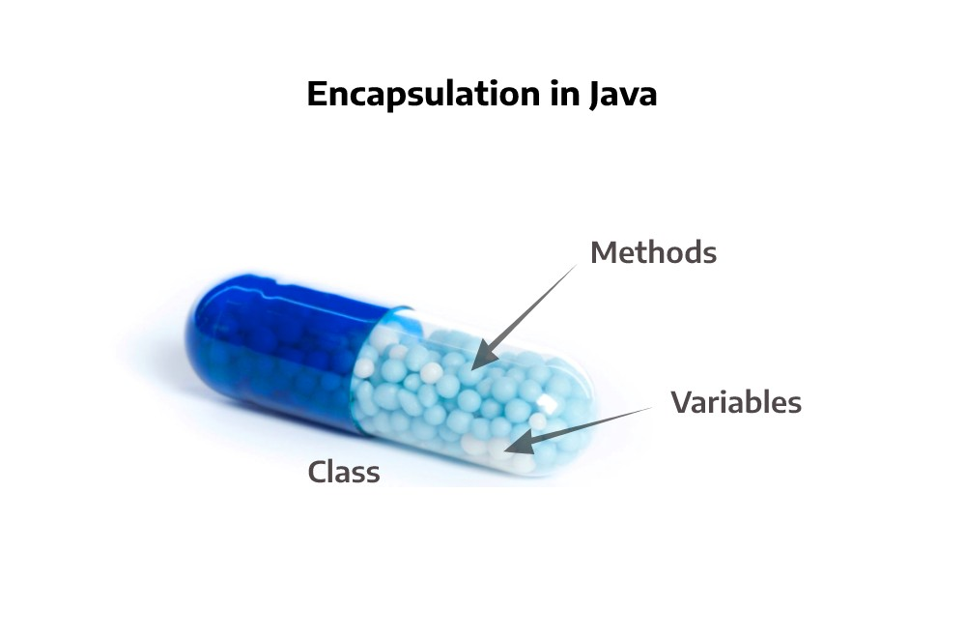
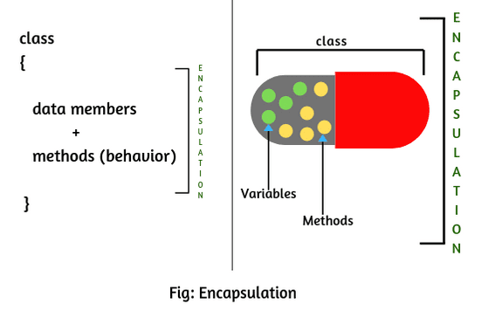
It refers to the process of combining data and functions within a single unit or object, and hiding the internal representation or state of an object from the outside world.

Slide 25

Abstraction
Abstraction refers to the practice of hiding the implementation details of a class and exposing only the necessary information to the outside world.

Slide 26
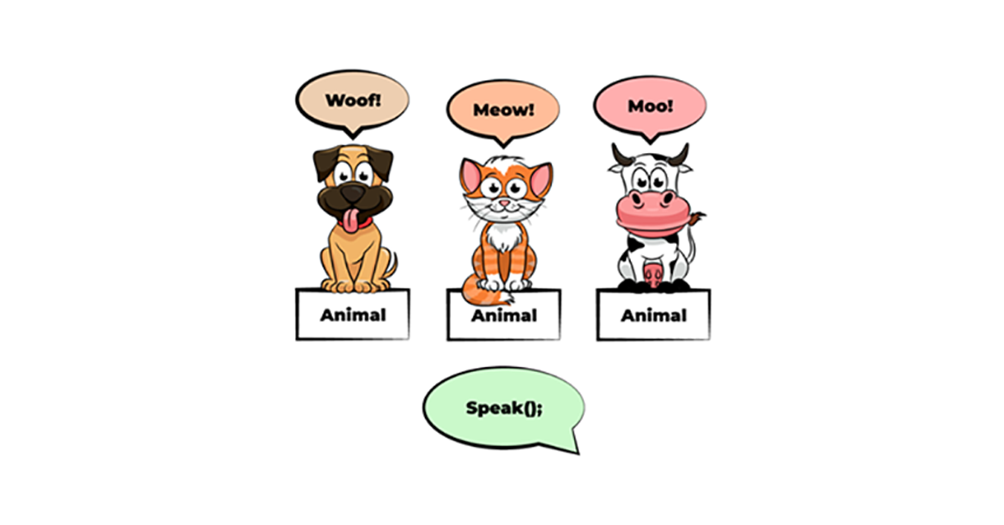
Polymorphism
It refers to the ability of an object to take on many forms. In Java, polymorphism is achieved through method overriding and method overloading.

Slide 27
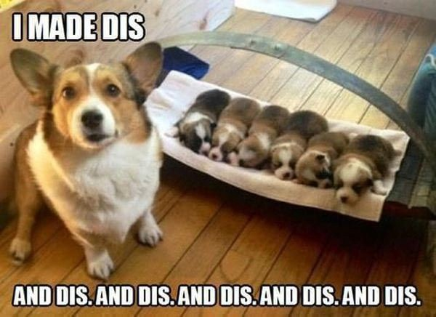
Inheritance

Slide 28
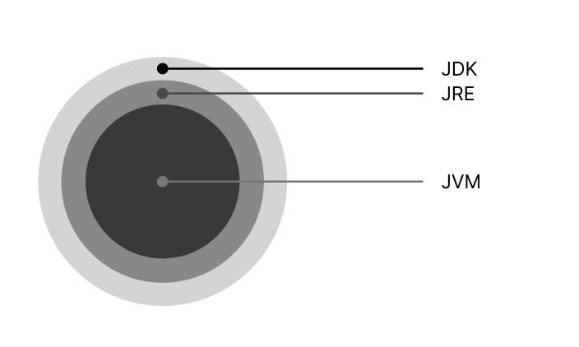
Chapter 1.2
JVM, Java environment(JRE/JDK), Java tools

Slide 29
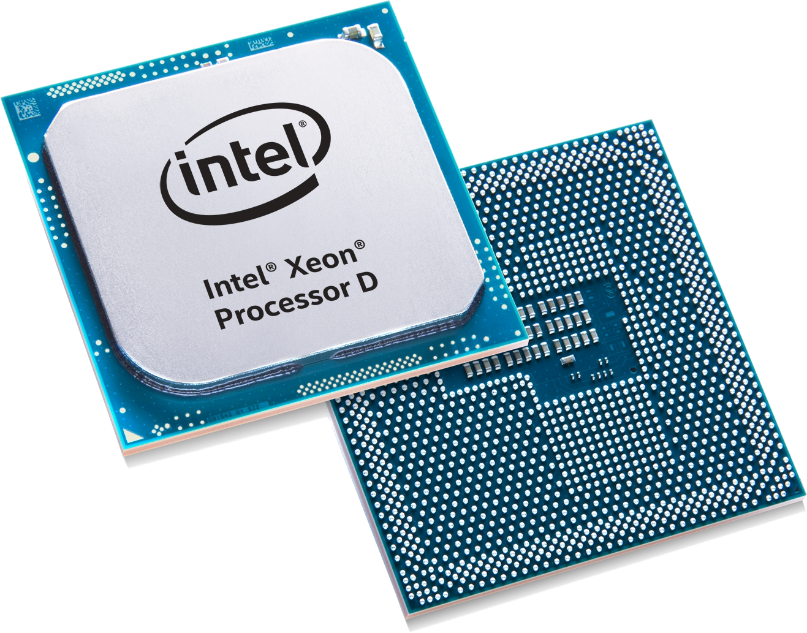
Let's first understand how machine understand anything.

Slide 30


يو ماما سمينة للغاية ، لقد التقطت صورة لعيد ميلادها الأخير وما زالت تطبع.
bro you ok?

Slide 31

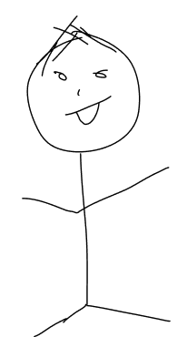
يو ماما سمينة للغاية ، لقد التقطت صورة لعيد ميلادها الأخير وما زالت تطبع.
Yo momma is so fat, I took a picture of her last Christmas and it's still printing.

Slide 32
Yo momma is so fat, I took a picture of her last Christmas and it's still printing.
Yo momma is so fat that Dora can't even explore her!

Slide 33
Compiler

Slide 34

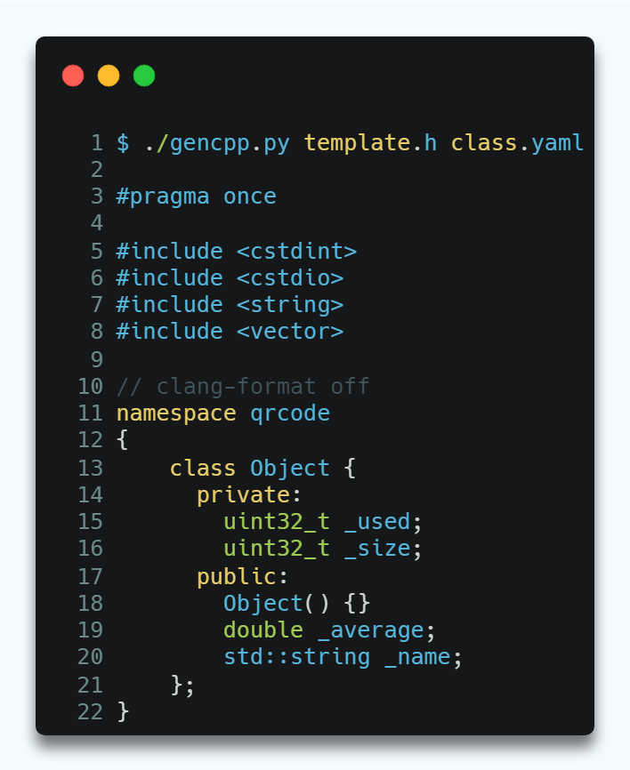


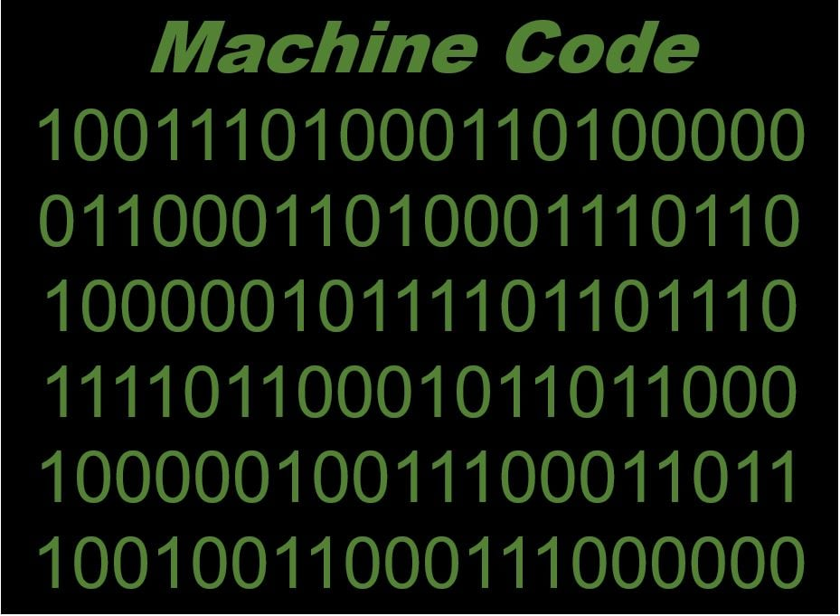
Code
Machine
compiler

Slide 35

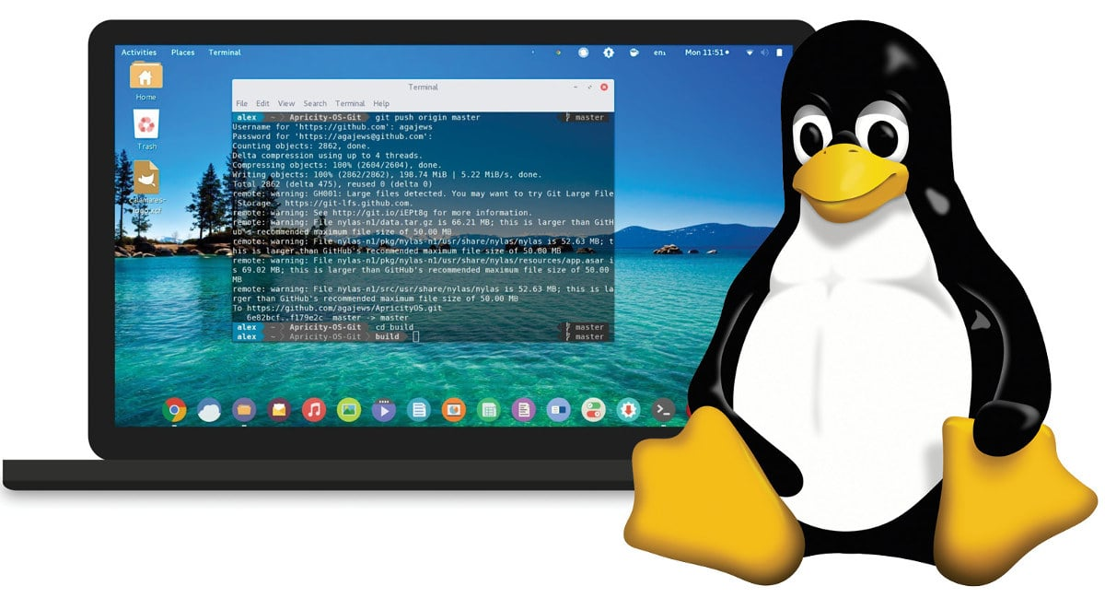

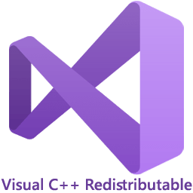


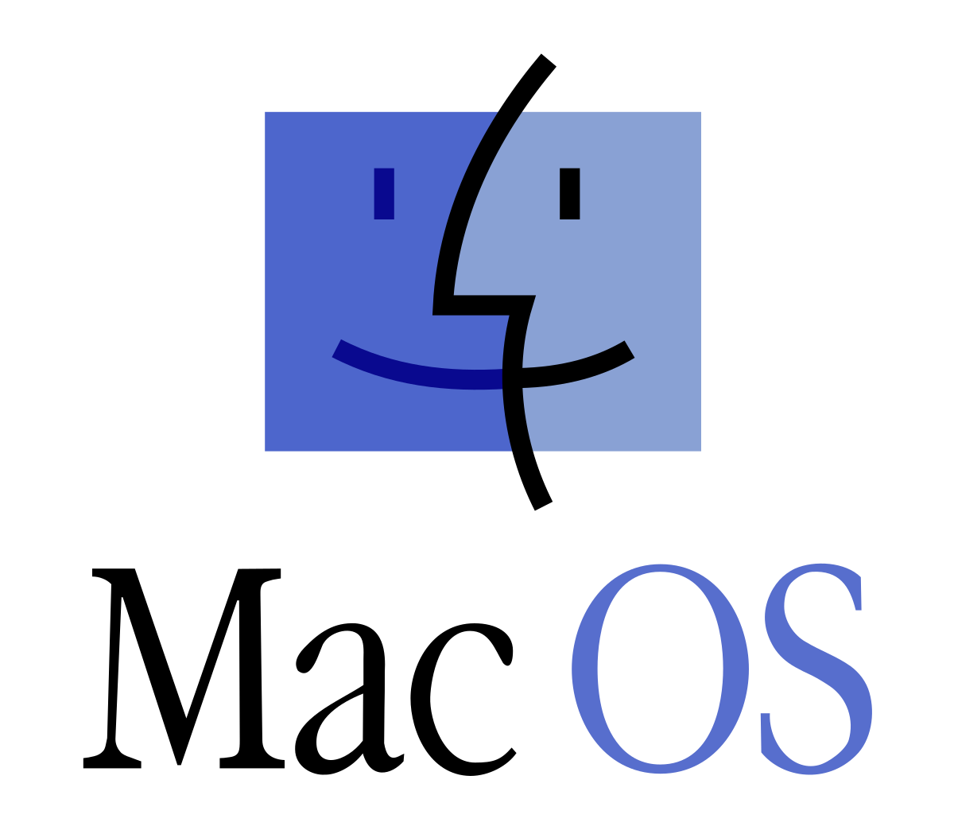
GCC (GNU Compiler Collection)
Microsoft Visual C++
Clang

Slide 36
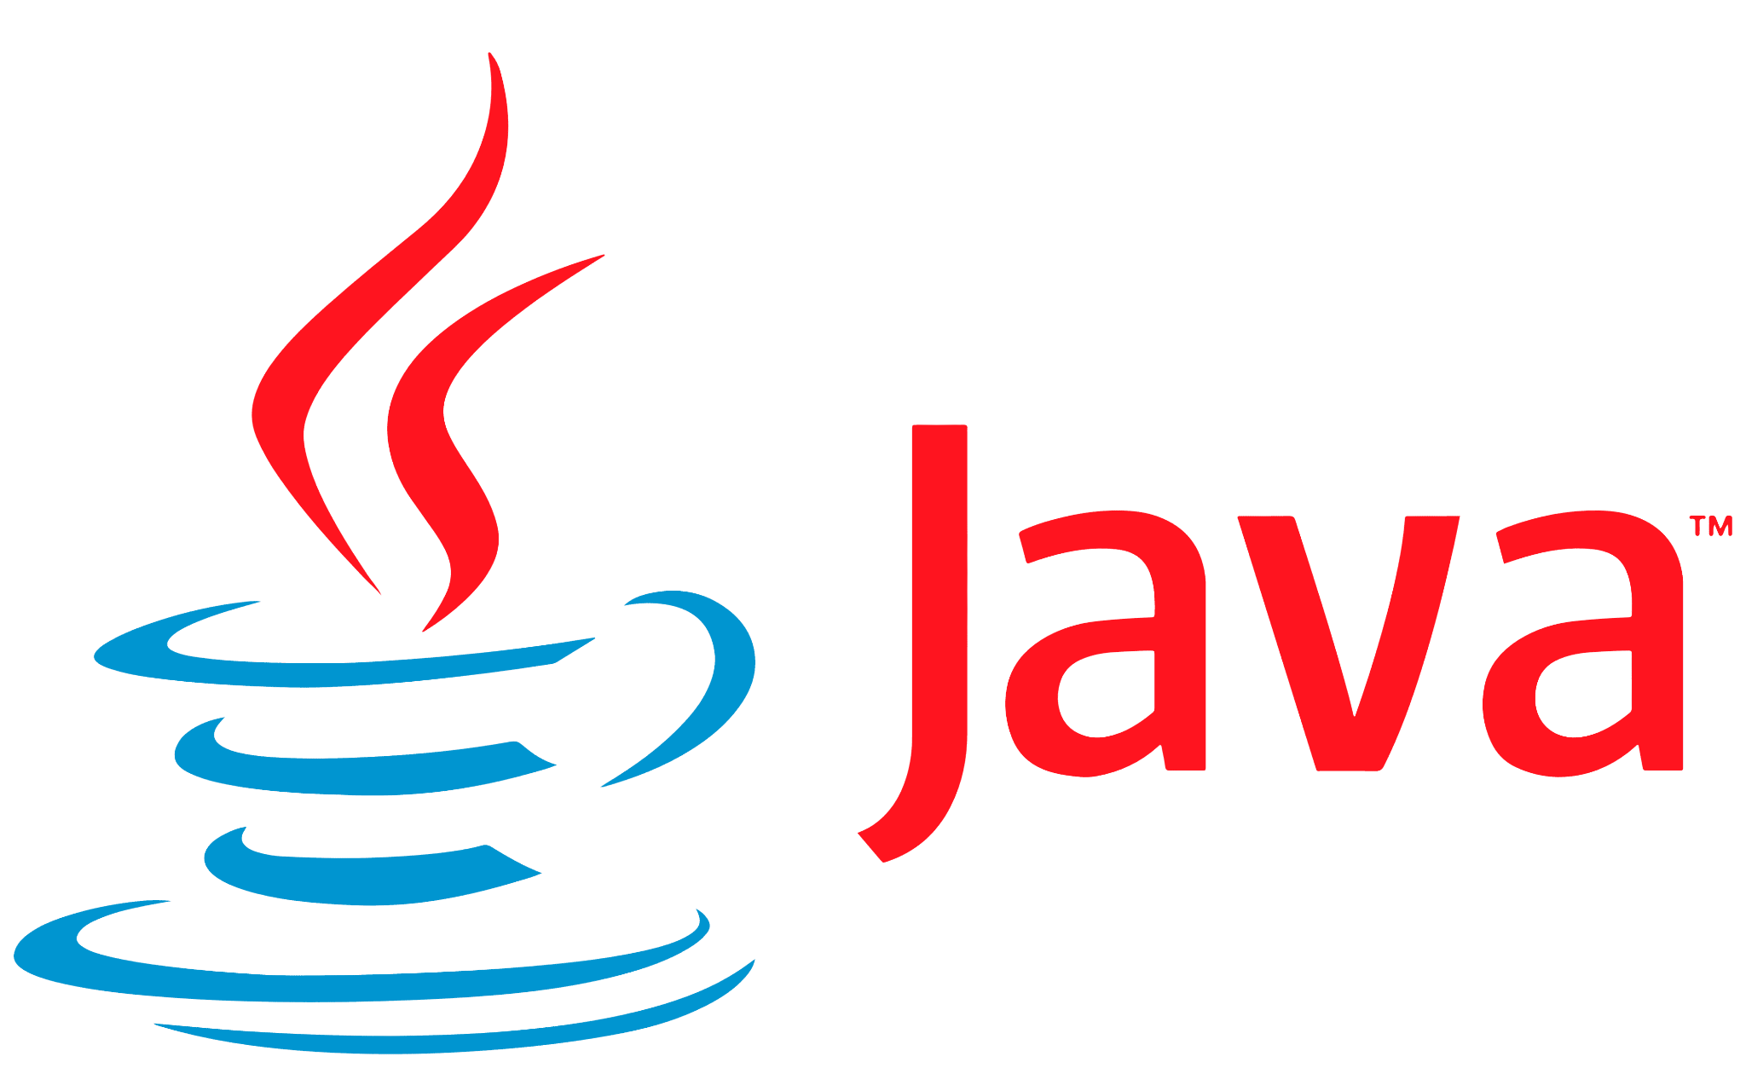
???????

Slide 37
Linux machine code
javac
bytecode
JVM
Linux machine code
JVM
Win machine code
JVM
mac machine code

Slide 38
JVM
The JVM is responsible for executing Java code. It provides a platform-independent execution environment for Java applications, ensuring that they run the same way on different operating systems.

Slide 39
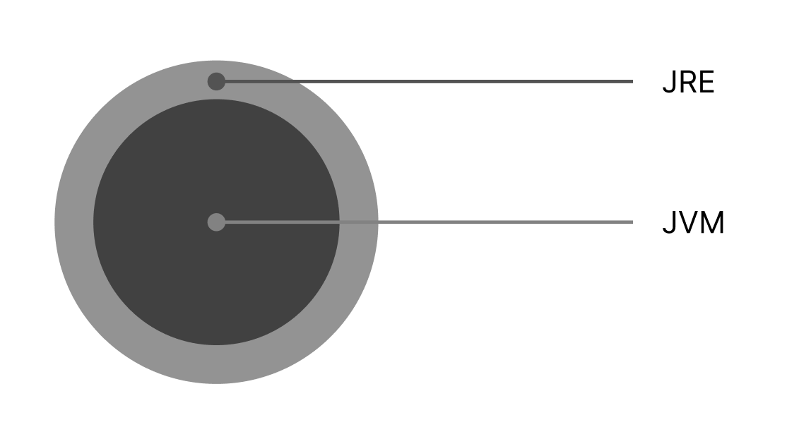
JRE
Java Runtime Environment
It is a software component that provides the minimum requirements for executing a Java application. The JRE includes the Java Virtual Machine (JVM)

Slide 40
JDK
Java Development Kit
JDK is a software development environment used for developing Java applications. It includes the JRE, which provides the minimum requirements for executing a Java application, as well as additional tools and libraries for developing, compiling, and testing Java code.

Slide 41
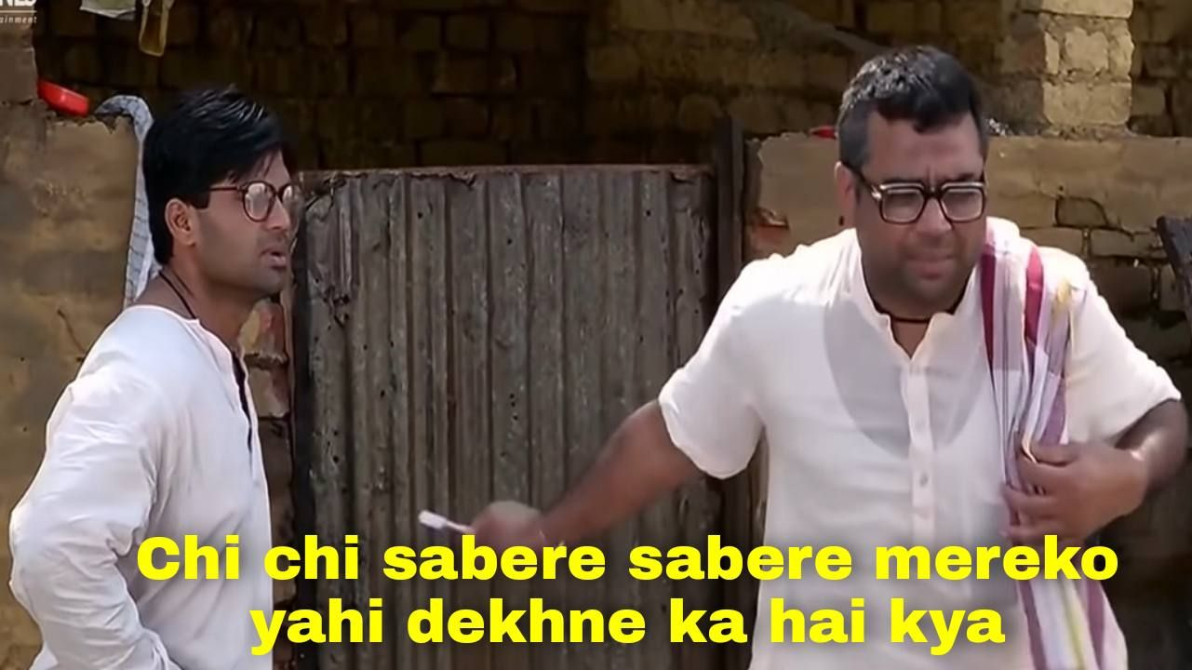
Chapter 1.3
Features of Java

Slide 42

Secure
Portable
Object Oriented
Robust
Multi-threading
Dynamic

Slide 43

Secure
Bytecode is safer
Lots of exception handling
Apis Encryption, digital signatures, and secure communication protocols
Better exception Handling
Java handles its memory automatically

Slide 44
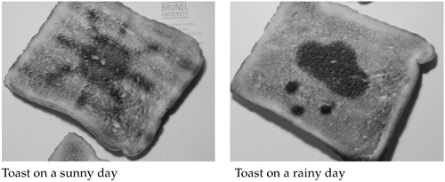
Portable

Slide 45
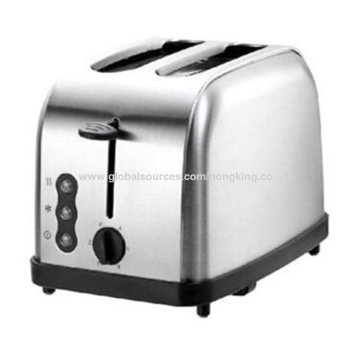

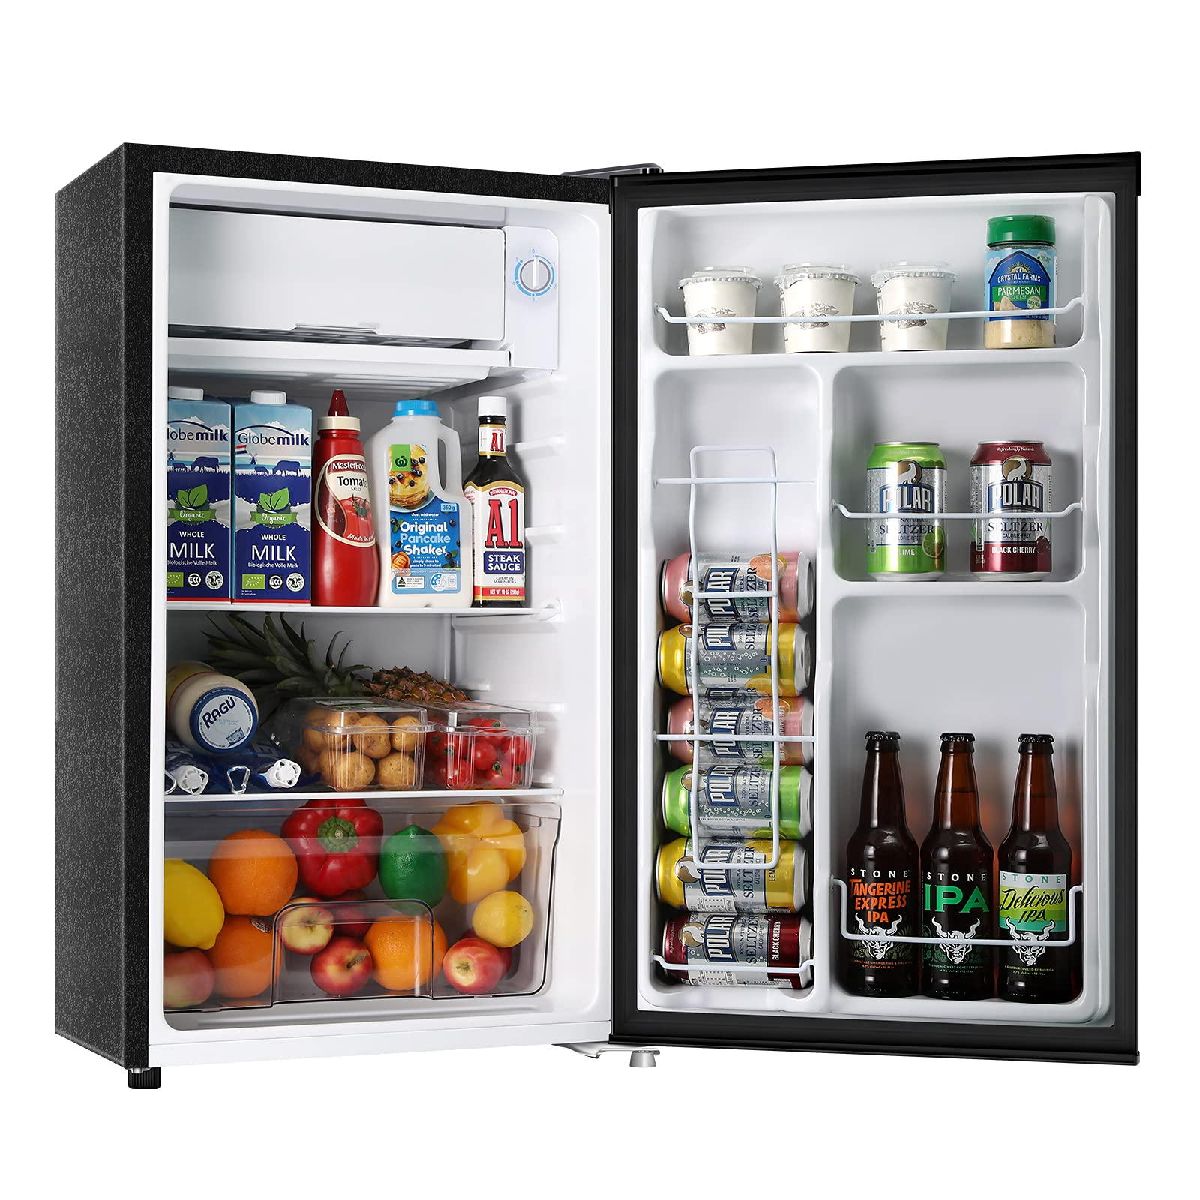
Portable
"write once, run anywhere" principle
Thanks to JVM and bytecode
Standard Libraries for all platform

Slide 46
Object Oriented
Objects
Classes
Encapsulation
Inheritance

Slide 47

Robust
Java is a language that is strong, dependable, and built to last.
Strict type system
Garbage collector 🧙‍♂️
No Pointer 🤩
Exception handling

Slide 48
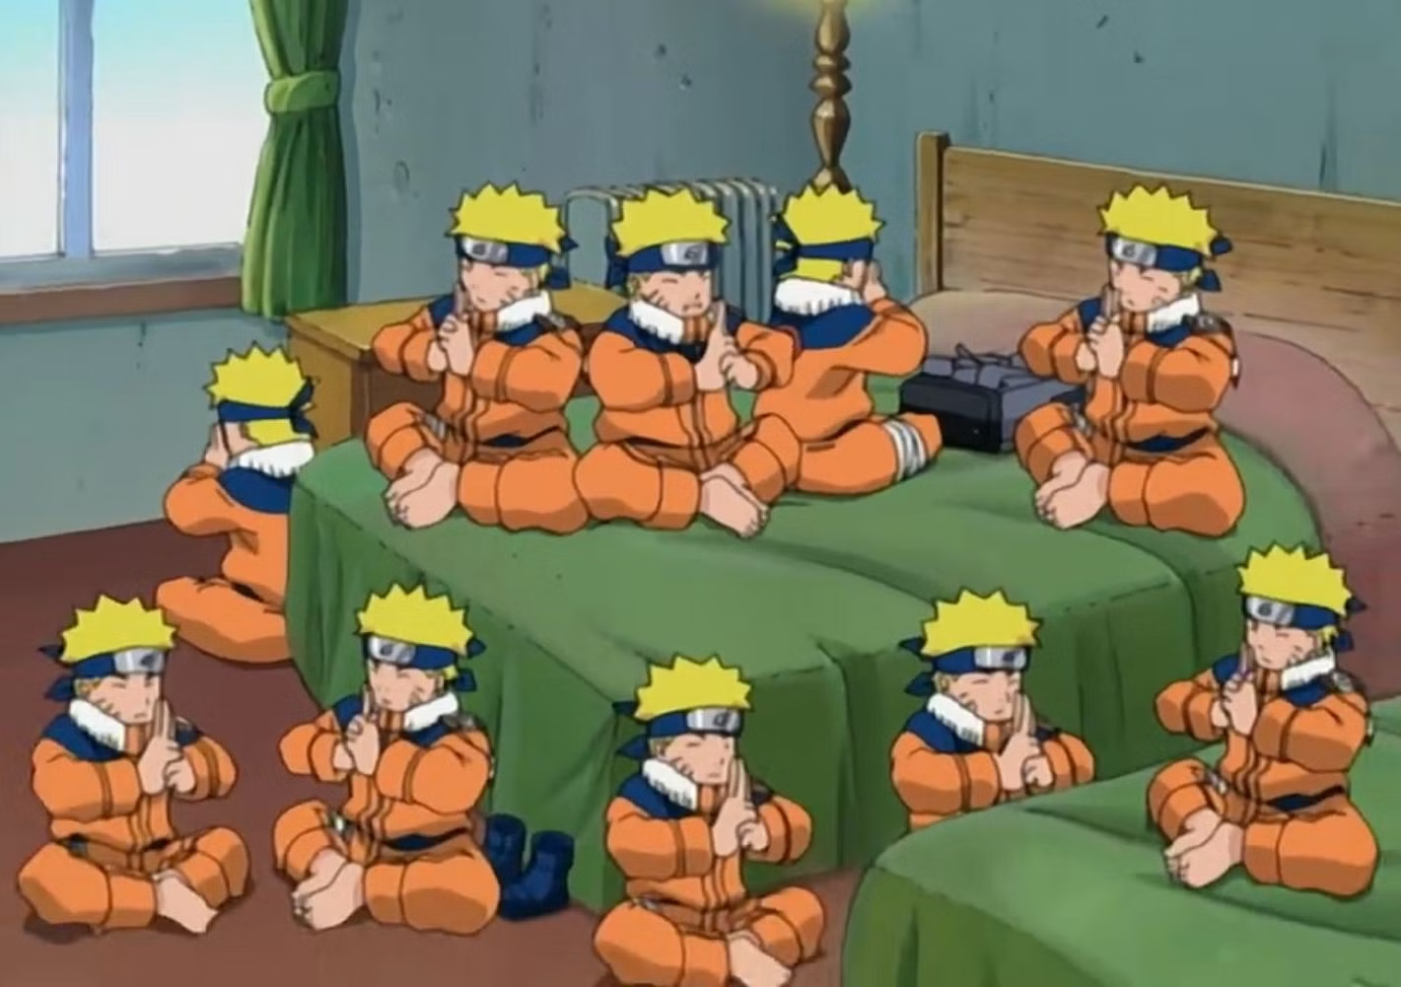
Multi-threading
A thread is like a separate program, executing concurrently

Slide 49
Dynamic
ClassLoader

